Slide 1



BUILDING
RECOMMENDATION
ENGINES
WITH SPRING

Slide 2


MICHAEL MINELLA
TWITTER: @MICHAELMINELLA
HOME PAGE: SPRING.IO/TEAM/MMINELLA

Slide 3


WHAT I’M NOT

Slide 4



Slide 5

https://github.com/mminella/RecommendationEngine

Slide 6

THANK YOU
SEBASTIAN SCHELTER
PAT FERREL

Slide 7


Slide 8
11
14
7
12
20
16
5
17
6
3
2
8
18
13
4
1
10
19
23
15
9

Slide 9

Notes:
Look at the site we’ll update
Also look at the technologies we’ll use

Slide 10

RECOMMENDATION
ALGORITHMS

Slide 11

/**
* @author Michael Minella
*/
@Configuration
@ComponentScan
@EnableAutoConfiguration
public class Application {
@Bean
ItemBasedRecommender recommender(DataSource dataSource) {
DataModel dataModel = new MySQLBooleanPrefJDBCDataModel(dataSource);
ItemSimilarity similarity = new MySQLJDBCItemSimilarity(dataSource);
AllSimilarItemsCandidateItemsStrategy candidateItemsStrategy =
new AllSimilarItemsCandidateItemsStrategy(similarity);
return new GenericItemBasedRecommender(dataModel, similarity, candidateItemsStrategy, candidateItemsStrategy);
}
public static void main(String[] args) {
SpringApplication.run(Application.class, args);
}
}

Slide 12


LET’S SET SOME
EXPECTATIONS

Slide 14
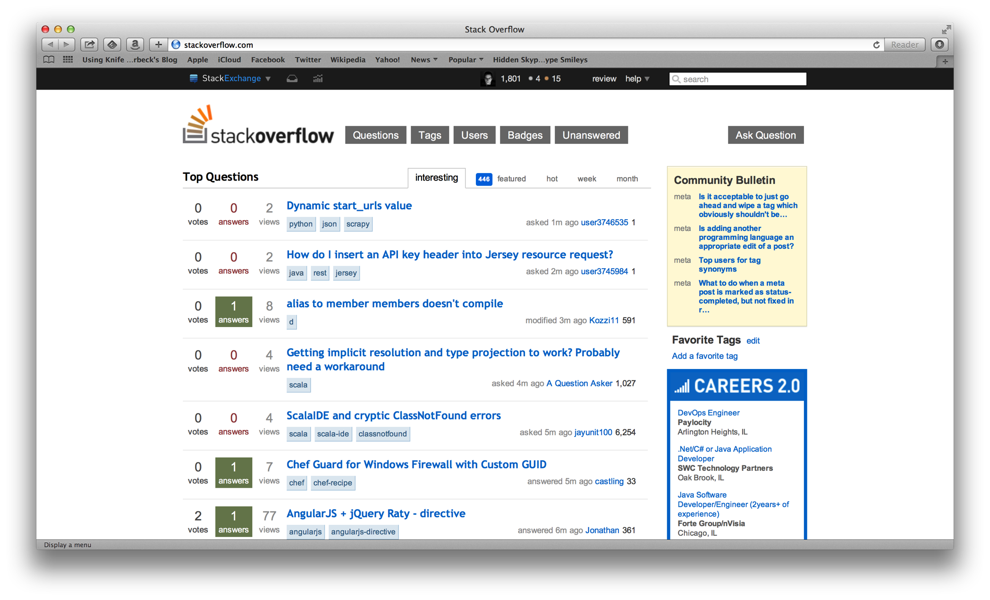

Slide 15
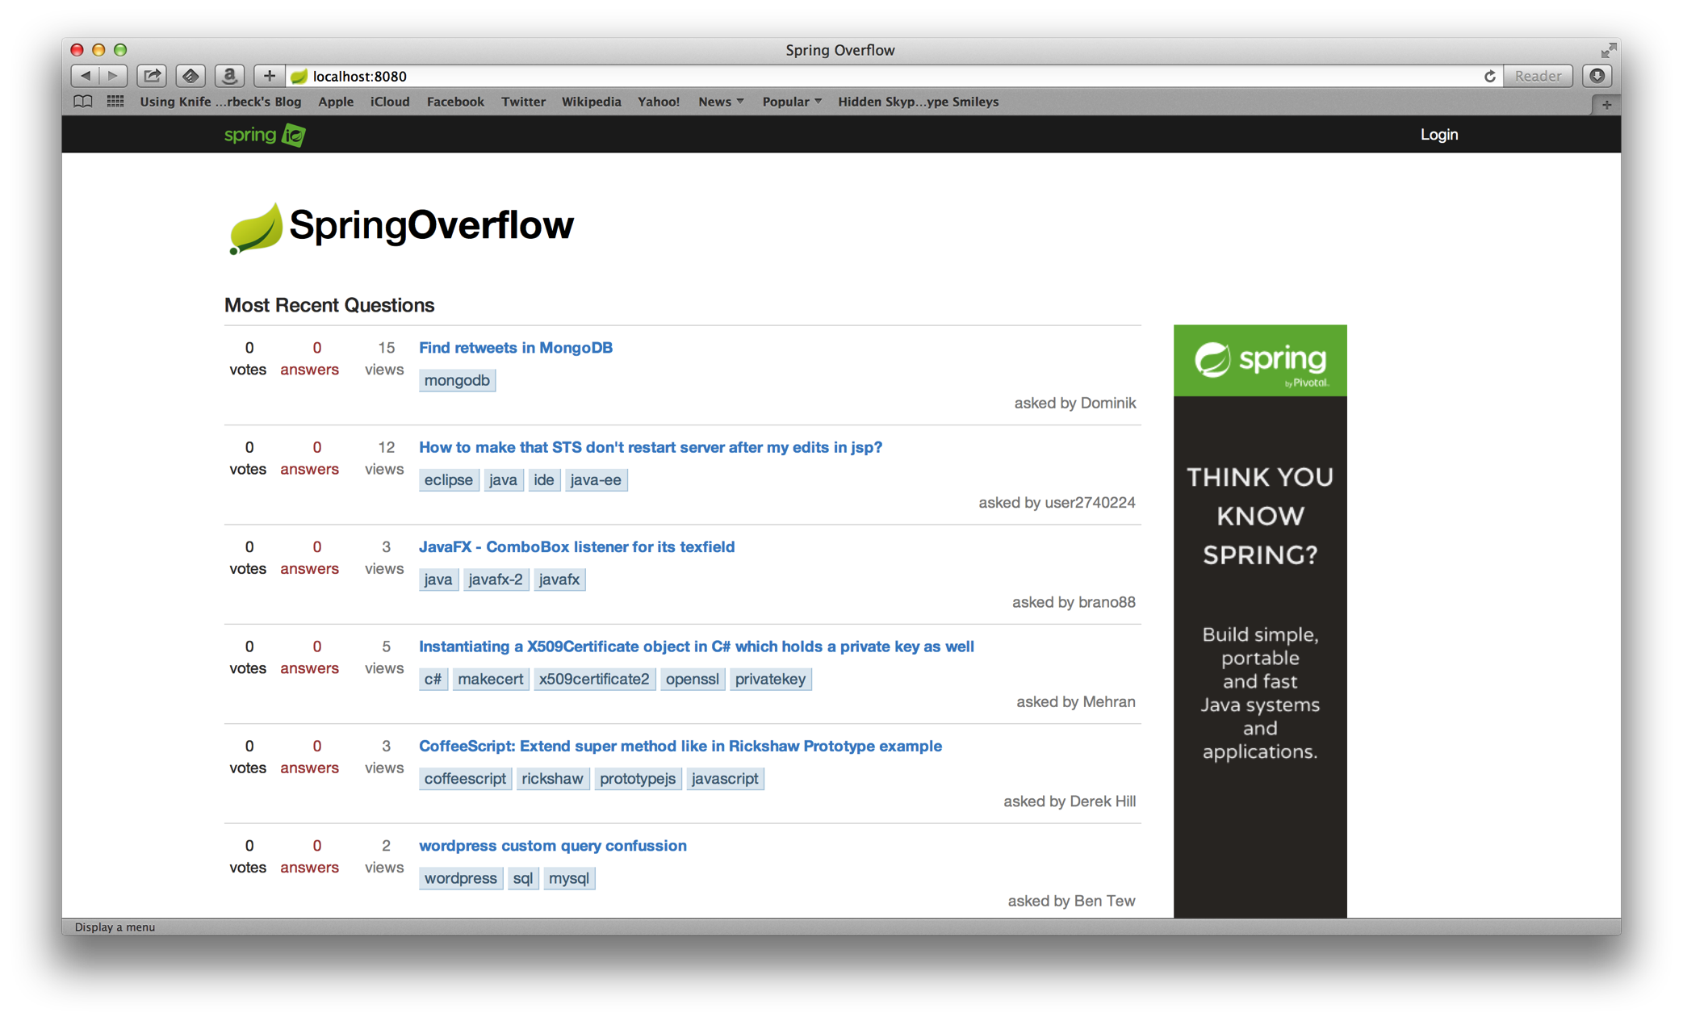

Slide 16
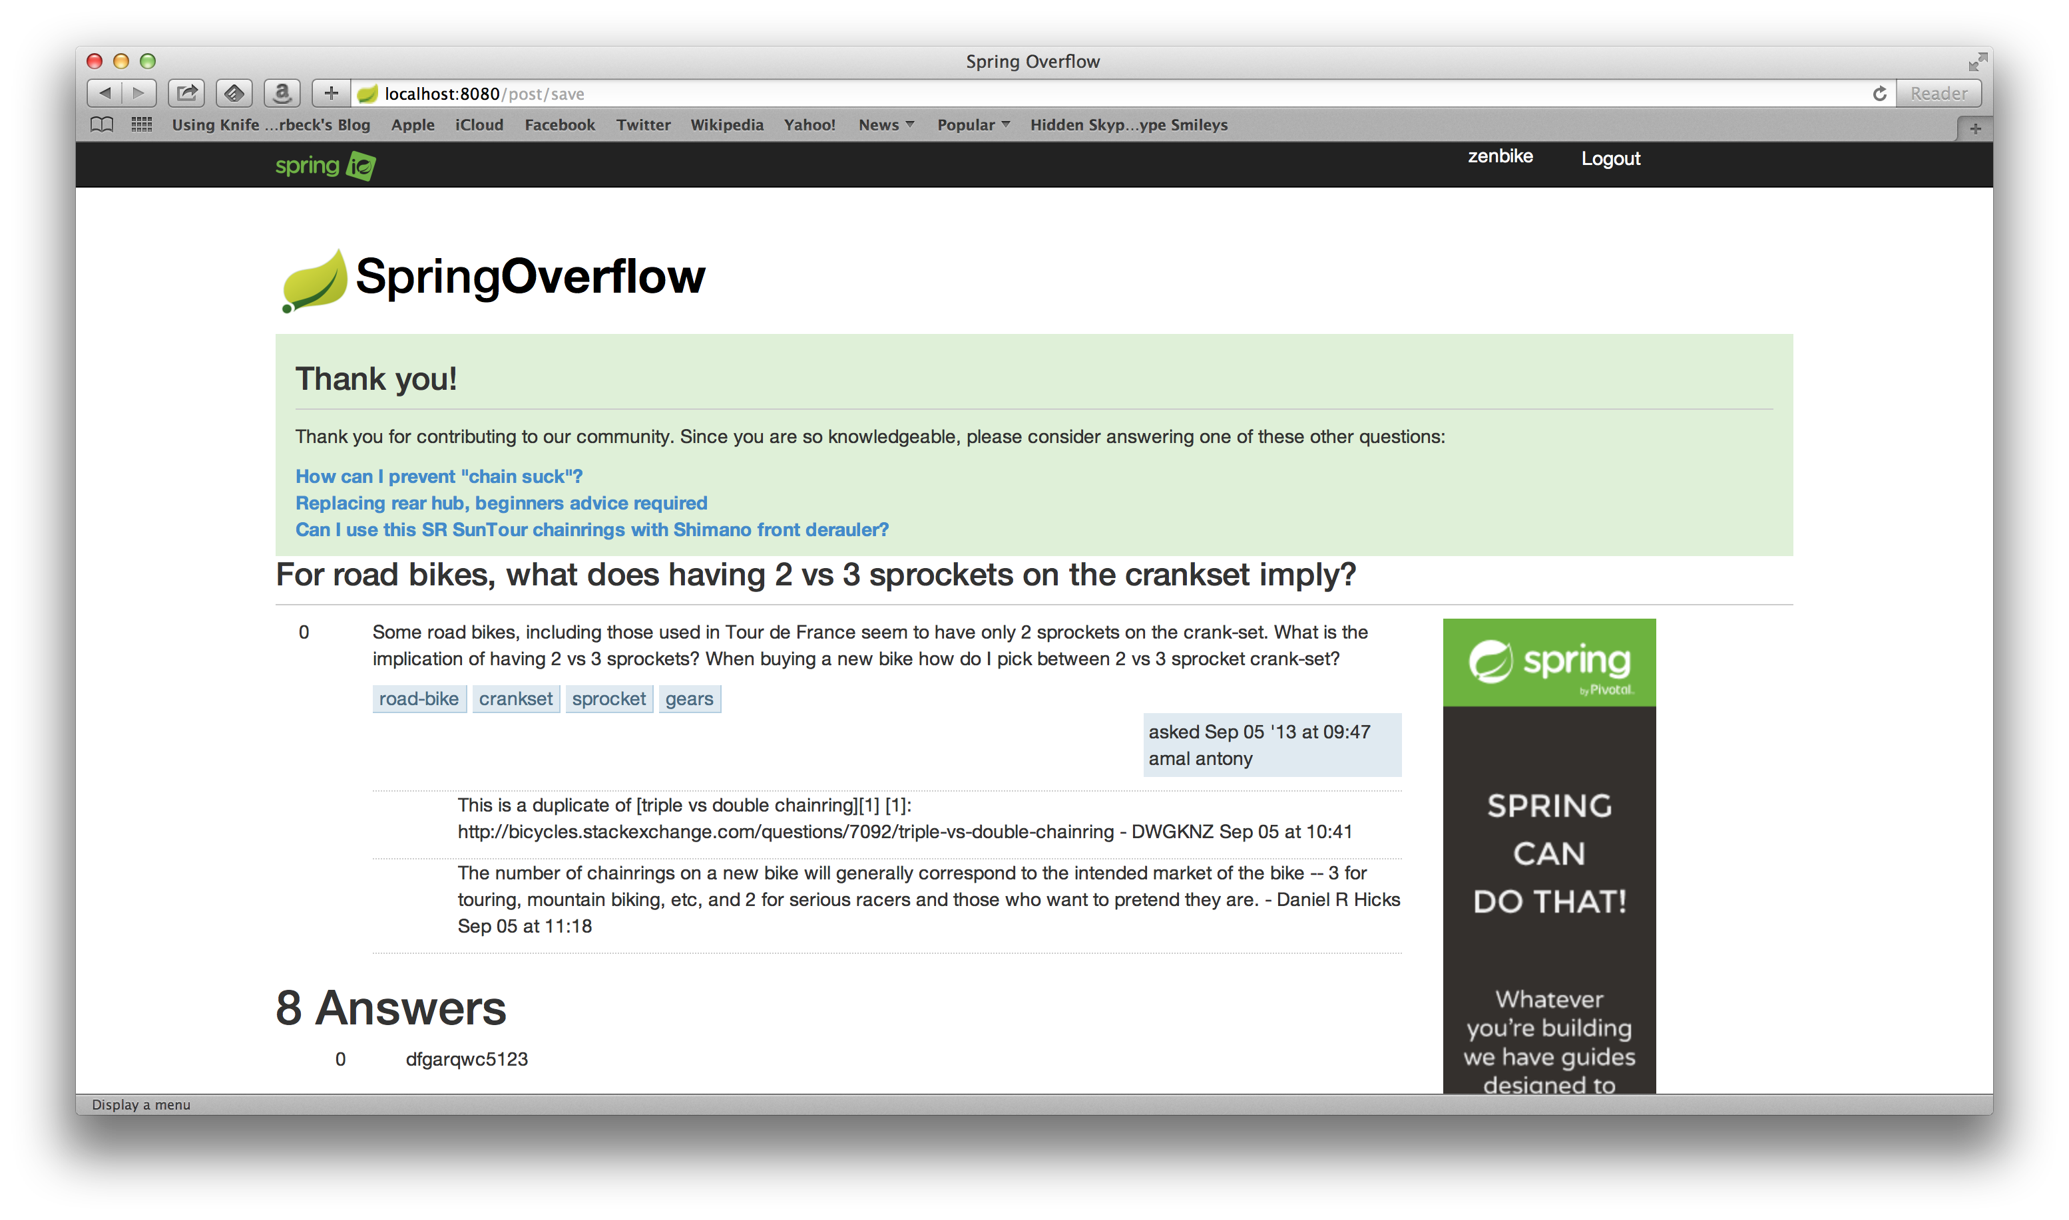

Slide 17
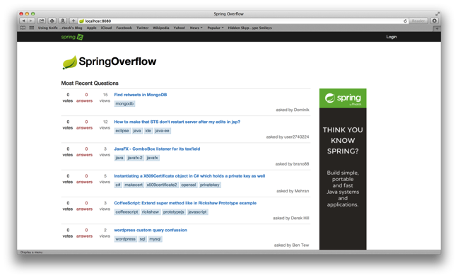




Slide 18

SCALE OF THE PROBLEM

Slide 19

MILLIONS OF
USERS

Slide 20









100,000’s OF
ITEMS

Slide 21

TOOLS AND
TECHNOLOGIES

Slide 22
1
SPRING BOOT
Notes:
Spring Boot, Spring Data JPA, Spring Core/MVC, Spring Security,

Slide 23
2
MYSQL

Slide 24
3
HADOOP

Slide 25
4
SPRING XD

Slide 26
5
MAHOUT

Slide 27

SPRING XD
EXTREME DATA

Slide 28


APPLICATION
COMPLEXITY

Slide 29
LOTS OF
BOILERPLATE

Slide 30

MANY DOMAINS TO
BRIDGE

Slide 31
INCONSISTENT
APIS

Slide 32
SOURCE, CHANEL, SINK
DATA FLOW MODEL
=
ADAPTER, CHANEL, FILTER, TRANSFORMER, ETC
EIP PATTERNS

Slide 33
JOB, CONNECTOR
IMPORT/EXPORT
=
JOB, ITEMREADER/ITEMWRITER
BATCH PROCESSING

Slide 34
WORKFLOW, ACTION
WORKFLOW
ORCHESTRATION
=
JOB, STEP
BATCH PROCESSING

Slide 35
SPRING XD
EXTREME DATA

Slide 36

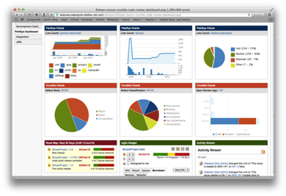





Ingestion
Orchestration
SPRING
Extraction
Real-time
Analytics
Notes:
Spring XD handles everything in the circle

Slide 37

DISTRIBUTED
RUNTIME

Slide 38


&
STREAMING
BATCH

Slide 39
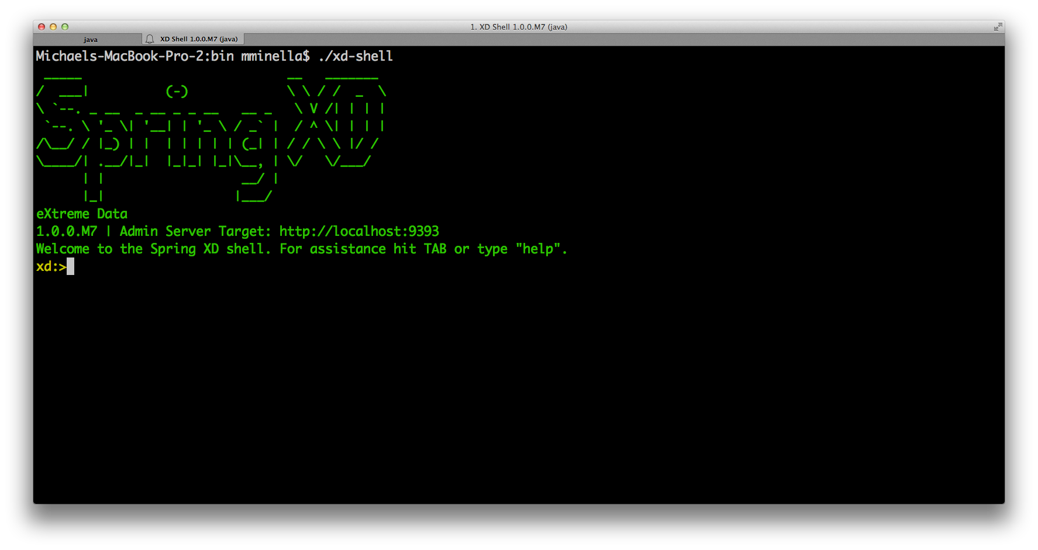

Slide 40
http
|
hdfs
--directory=/xd/dir1
--port=8181
filter --expression=“payload?.price > 3.00” |

Slide 41
BATCH PROCESSING FOR
HEAVY LIFTING

Slide 42

JOB

Slide 43
STEP

Slide 44

TASKLET

Slide 45

CHUNK

Slide 46

SPRING FOR
APACHE HADOOP

Slide 47


Slide 48

TOTAL LINES OF CUSTOM CODE
47 Lines of Java
29 Lines of XML
6 Spring XD Shell Commands

Slide 49
RECOMMENDATION
ALGORITHMS

Slide 50


PREDICTING THE
FUTURE

Slide 51

COLLABORATIVE
FILTERING

Slide 52

TWO OPTIONS

Slide 53

USER BASED
Notes:
Compare users. Determine what users exhibit the same patterns as the current user.

Slide 54
USER
ITEM 1
ITEM 2
ITEM 3
ITEM 4
ITEM 5
DEREK
MICHAEL
PHIL
DARREL
?
Notes:
Compare users. Determine what users exhibit the same patterns as the current user.

Slide 55
USER BASED
Notes:
Handles unique scenarios really well

Slide 56
USER BASED
Notes:
Doesn’t scale
Rate of refresh needs to bee too quick
Must hold large amounts of data per user to be able to compare

Slide 57




ITEM BASED
Notes:
Invented by Amazon (you bought X…you may be interested in Y)
Item Based scales better (a function of your catalog, not your customer base)
Item Based doesn’t need to be updated as frequently

Slide 58
ITEM
DEREK
MICHAEL
PHIL
DARREL
ITEM 1
ITEM 2
ITEM 3
ITEM 4
?
ITEM 5

Slide 59
ITEM BASED
Notes:
Scales very well

Slide 60
ITEM BASED
Notes:
The few can impact the many

Slide 61
PEOPLE ARE
FUNNY

Slide 62
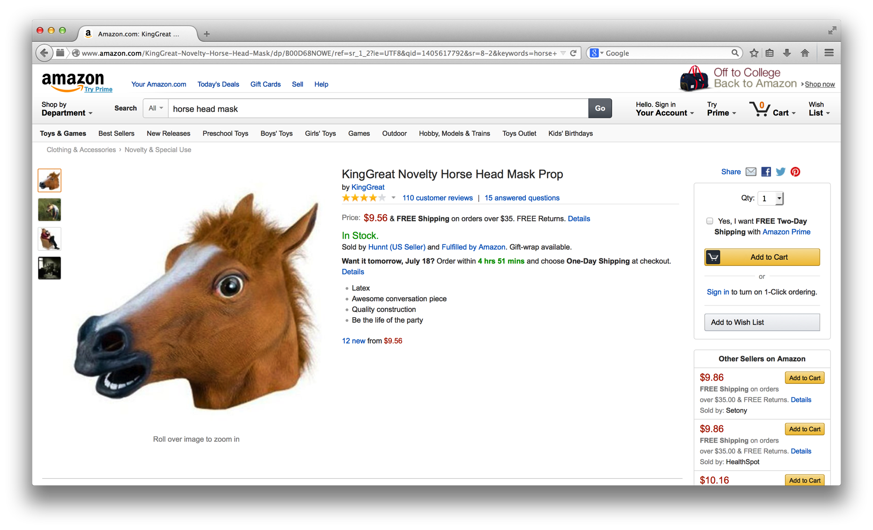

Slide 63
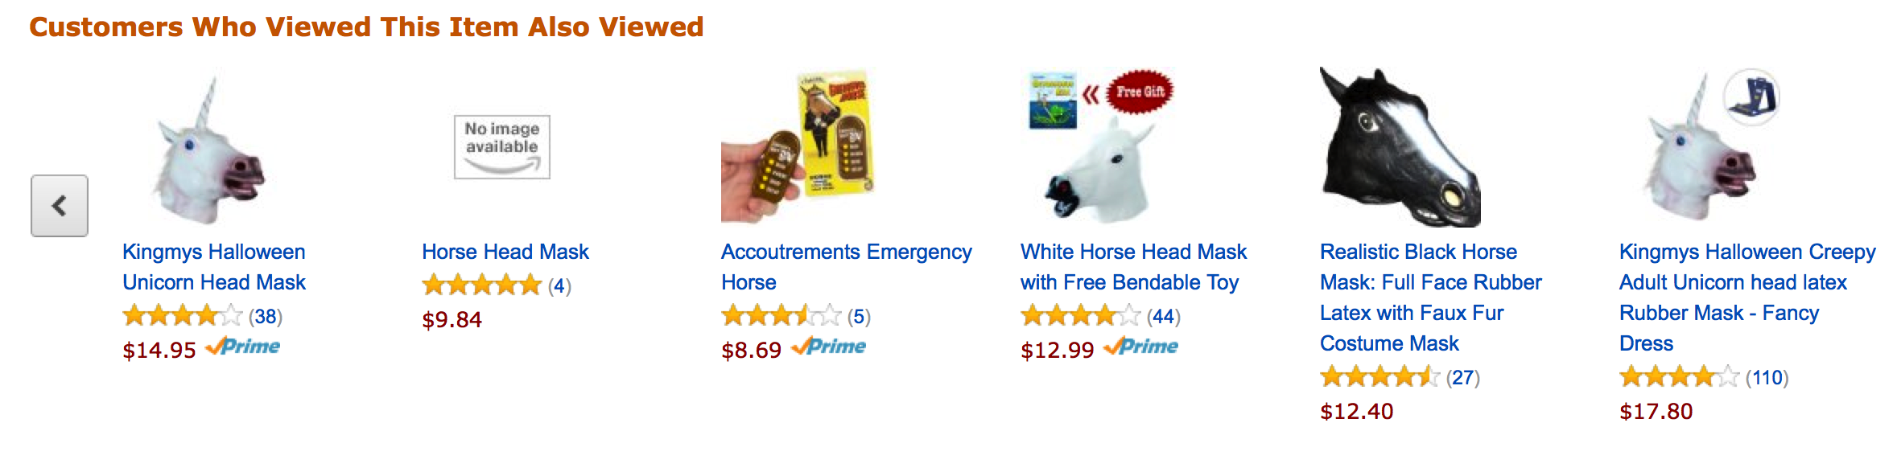
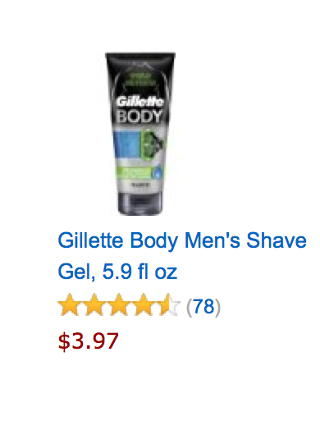
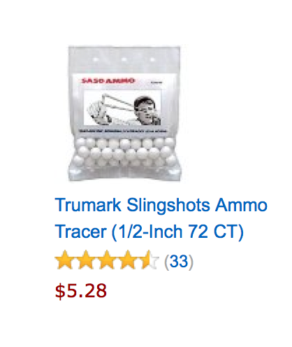

Slide 64
/**
* @author Michael Minella
*/
@Configuration
@ComponentScan
@EnableAutoConfiguration
public class Application {
@Bean
ItemBasedRecommender recommender(DataSource dataSource) {
DataModel dataModel = new MySQLBooleanPrefJDBCDataModel(dataSource);
ItemSimilarity similarity = new MySQLJDBCItemSimilarity(dataSource);
AllSimilarItemsCandidateItemsStrategy candidateItemsStrategy =
new AllSimilarItemsCandidateItemsStrategy(similarity);
return new GenericItemBasedRecommender(dataModel, similarity, candidateItemsStrategy, candidateItemsStrategy);
}
public static void main(String[] args) {
SpringApplication.run(Application.class, args);
}
}

Slide 65
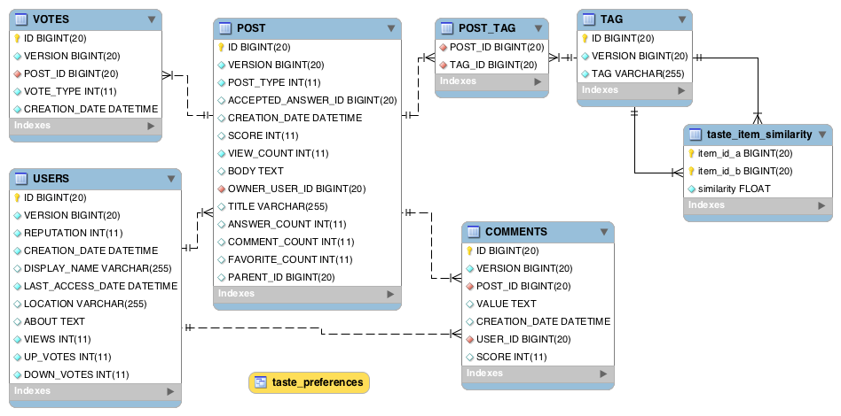

Slide 66
USER_ID, TAG_ID, VOTES
TAG_ID, TAG_ID, SCORE
Notes:
File in HDFS with following format:
userId, tagid, score
Results from Mahout job
tagId, tagId, score

Slide 67
/**
* @author Michael Minella
*/
@Configuration
@ComponentScan
@EnableAutoConfiguration
public class Application {
@Bean
ItemBasedRecommender recommender(DataSource dataSource) {
DataModel dataModel = new MySQLBooleanPrefJDBCDataModel(dataSource);
ItemSimilarity similarity = new MySQLJDBCItemSimilarity(dataSource);
AllSimilarItemsCandidateItemsStrategy candidateItemsStrategy =
new AllSimilarItemsCandidateItemsStrategy(similarity);
return new GenericItemBasedRecommender(dataModel, similarity, candidateItemsStrategy, candidateItemsStrategy);
}
public static void main(String[] args) {
SpringApplication.run(Application.class, args);
}
}

Slide 68
LOOKING INTO THE
FUTURE

Slide 69

SNAPSHOTS AHEAD!

Slide 70

NOW WITH
Notes:
In this use case Spark really doesn’t change things.

Slide 71

MAP REDUCE
Notes:
General distributed computing framework

Slide 72
MAP REDUCE
PROBLEMS
Notes:
General distributed computing framework

Slide 73
API IS VERY
LOW LEVEL

Slide 74

HIGH
LATENCY
Notes:
Three steps to the job
Map
Shuffle
Reduce
Can’t do one before the previous one completes

Slide 75

NOT ALWAYS A
GOOD FIT
Notes:
Map only jobs for example

Slide 76


Slide 77
POTENTIALLY
FASTER
Notes:
RDD provides reduced IO for speed improvements

Slide 78

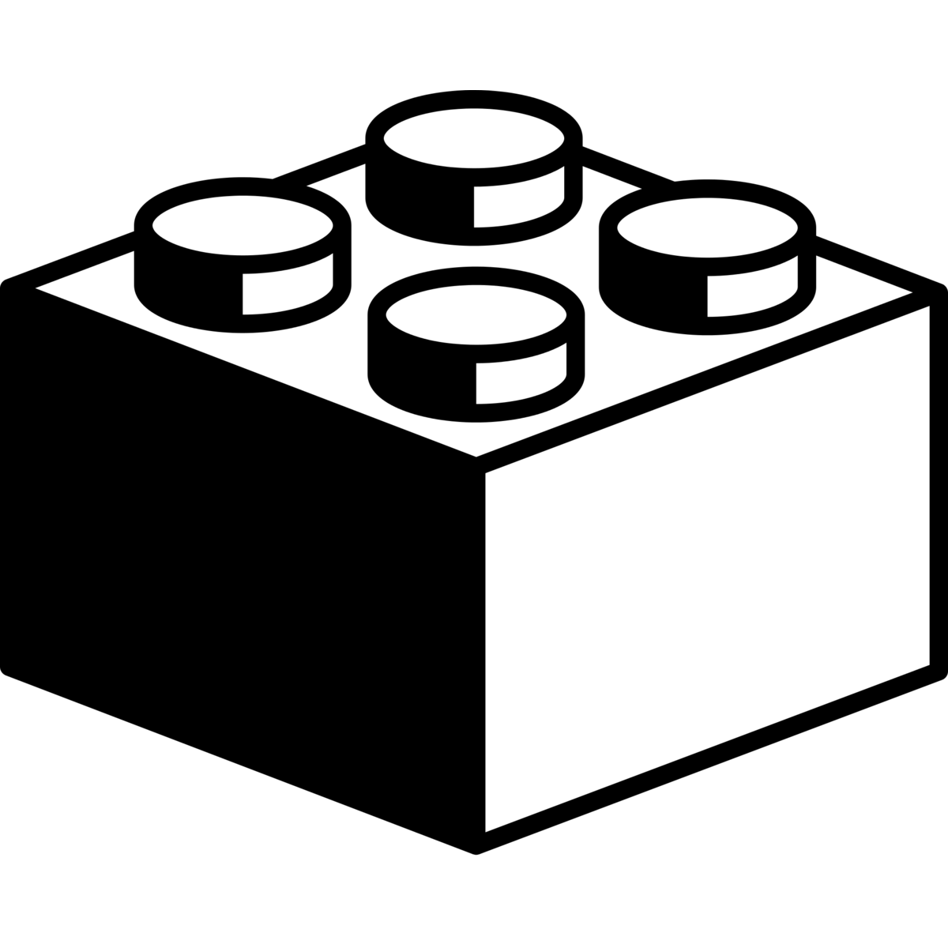
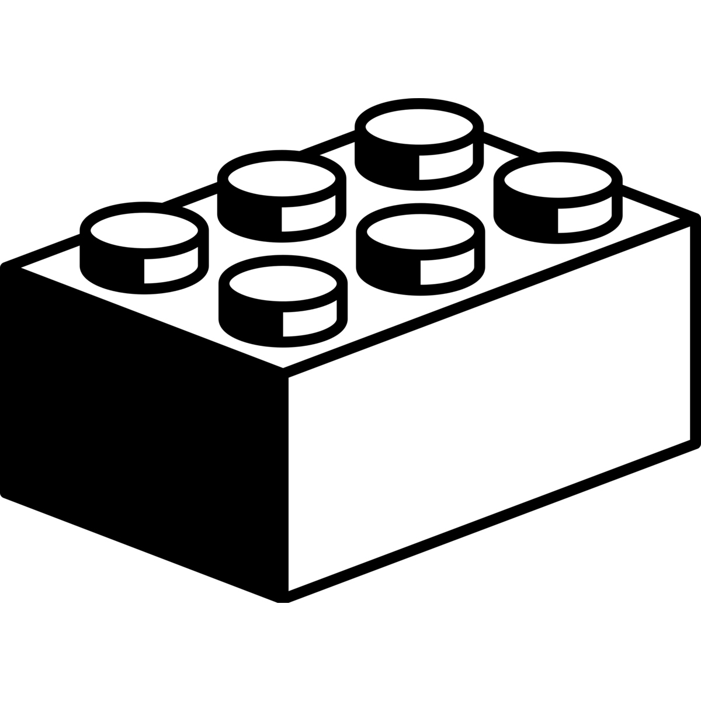

HIGHER LEVEL
APIS
Notes:
Spark Context – Kind of like a connection in that it tells Spark how to access the cluster.
Two things you can do to an RDD
Transformations – Create new dataset based on some change
Actions – Return value to driver program

Slide 79
scala> textFile.count()
res0: Long = 126
Notes:
Action that shows the number of items in the RDD

Slide 81
USER_ID, TAG_ID, VOTES
TAGID,TAGID:RANK…
Notes:
File in HDFS with following format:
userId, tagid, score
Results from Mahout job
tagId tagId:rank
Rank is Log Likelihood Ratio (not 0-1 range)

Slide 82
1
USE A
SEARCH ENGINE
Notes:
General distributed computing framework

Slide 83
2
DATA
NORMALIZATION
Notes:
General distributed computing framework

Slide 84
/**
* @author Michael Minella
*/
@Configuration
@ComponentScan
@EnableAutoConfiguration
public class Application {
@Bean
ItemBasedRecommender recommender(DataSource dataSource) {
DataModel dataModel = new MySQLBooleanPrefJDBCDataModel(dataSource);
ItemSimilarity similarity = new MySQLJDBCItemSimilarity(dataSource);
AllSimilarItemsCandidateItemsStrategy candidateItemsStrategy =
new AllSimilarItemsCandidateItemsStrategy(similarity);
return new GenericItemBasedRecommender(dataModel, similarity, candidateItemsStrategy, candidateItemsStrategy);
}
public static void main(String[] args) {
SpringApplication.run(Application.class, args);
}
}

Slide 86

Learn More. Stay Connected.
Twitter: twitter.com/springcentral
YouTube: spring.io/video
LinkedIn: spring.io/linkedin
Google Plus: spring.io/gplus
Spring Batch
Project: spring.io/spring-batch
Github: github.com/spring-projects/spring-batch
Jira: jira.spring.io/browse/BATCH
Spring Boot
Project: spring.io/spring-boot
Github: github.com/spring-projects/spring-boot
Spring XD
Project: spring.io/spring-xd
Github: github.com/spring-projects/spring-xd
Jira: jira.spring.io/browse/XD

Slide 87




























Users by Vittorio Maria Vecchi
from The Noun Project
Check Box by Hrag Chanchanian
from The Noun Project
Question by Jessica Lock
from The Noun Project
Servers by Jaime Carrion
from The Noun Project
Crane by Kenneth Von Alt
from The Noun Project
Running by Dimiter Petrov
from The Noun Project
Scale by Edward Boatman
from The Noun Project
Nut by Naomi Atkinson
from The Noun Project
Funnel by Volodin Anton
from The Noun Project
Circuit by Piotrek Chuchla
from The Noun Project
Puzzle by Matthew Hall
from The Noun Project
Running by Dimiter Petrov
from The Noun Project
Thumbs Up by Jørgen Bovolden
from The Noun Project
Network by Mister Pixel
from The Noun Project
Puzzle by Eric M. Ellis
from The Noun Project
People by Wilson Joseph
from The Noun Project
Database by Anton Outkine
from The Noun Project
Move by Dmitry Baranovskiy
from The Noun Project
Flow Chart by Michael Wohlwend
from The Noun Project
Algebra by Ilsur Aptukov
from The Noun Project
Fork by Dmitry Baranovskiy
from The Noun Project
Maze by Gilbert Bages
from The Noun Project
Abacus byAlice Mortaro
from The Noun Project
Stopwatch by Scott Lewis
from The Noun Project
Lego by jon trillana
from The Noun Project
Lego by jon trillana
from The Noun Project
Lego by jon trillana
from The Noun Project
Lego by Jake Dunham
from The Noun Project

Slide 88

The
End

